Slide 1

Arm Wrestling Training Robot
Final Presentation
Elif Gündoğan, Samed Bayer & Nilay Meltem Yıldırım

Slide 2

Outline
Problem Definition
Proposed Solution
Detailed Design & Analysis
Motor Specifications
Sensors and Control Mechanism
Stress Analyses
Algorithm and Example Scenarios
Cost Analysis
Conclusion
References
Me429 - ARM WRESTLING TRAINING ROBOT

Slide 3
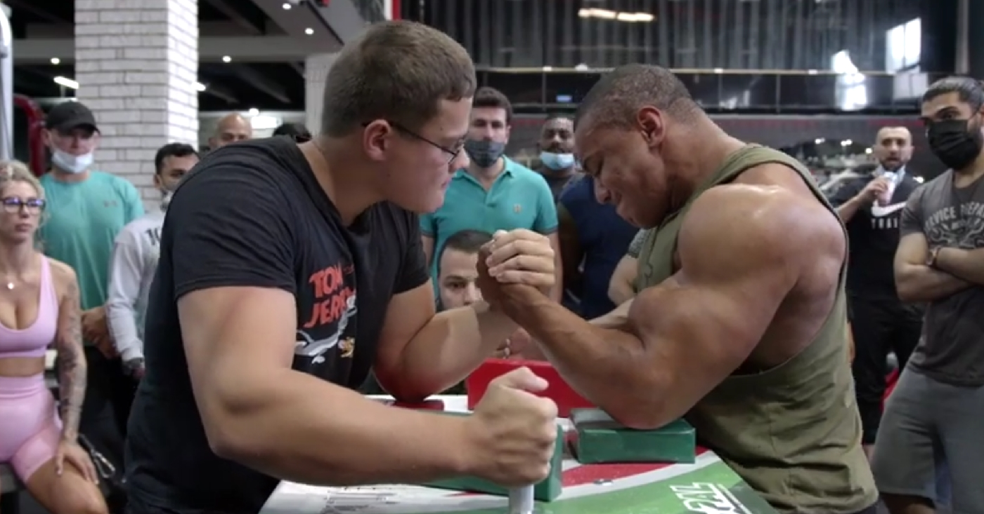
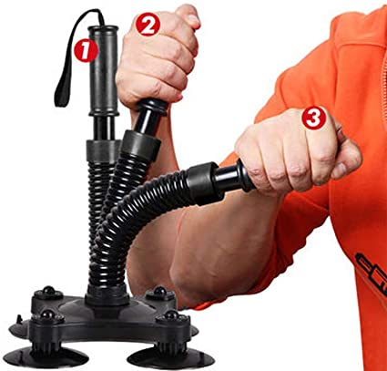
Problem Definition
WITH OTHER PEOPLE
[1]
[2]
CLASSIC ARM WRESTLING TRAINING
METHODS
USING EXTRA SPORTS EQUIPMENT
Me429 - ARM WRESTLING TRAINING ROBOT // Problem Definition

Slide 4
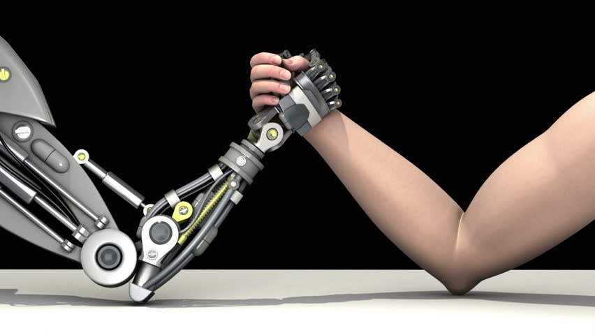
Problem Definition
[3]
Design a robotic arm that
Measures the torque applied by the opponent at different positions
Varies the actuator torque to respond to the opponent
Offers a realistic arm wrestling feeling
Gives feedback to the wrestler
Safe operation
Me429 - ARM WRESTLING TRAINING ROBOT // Problem Definition

Slide 5
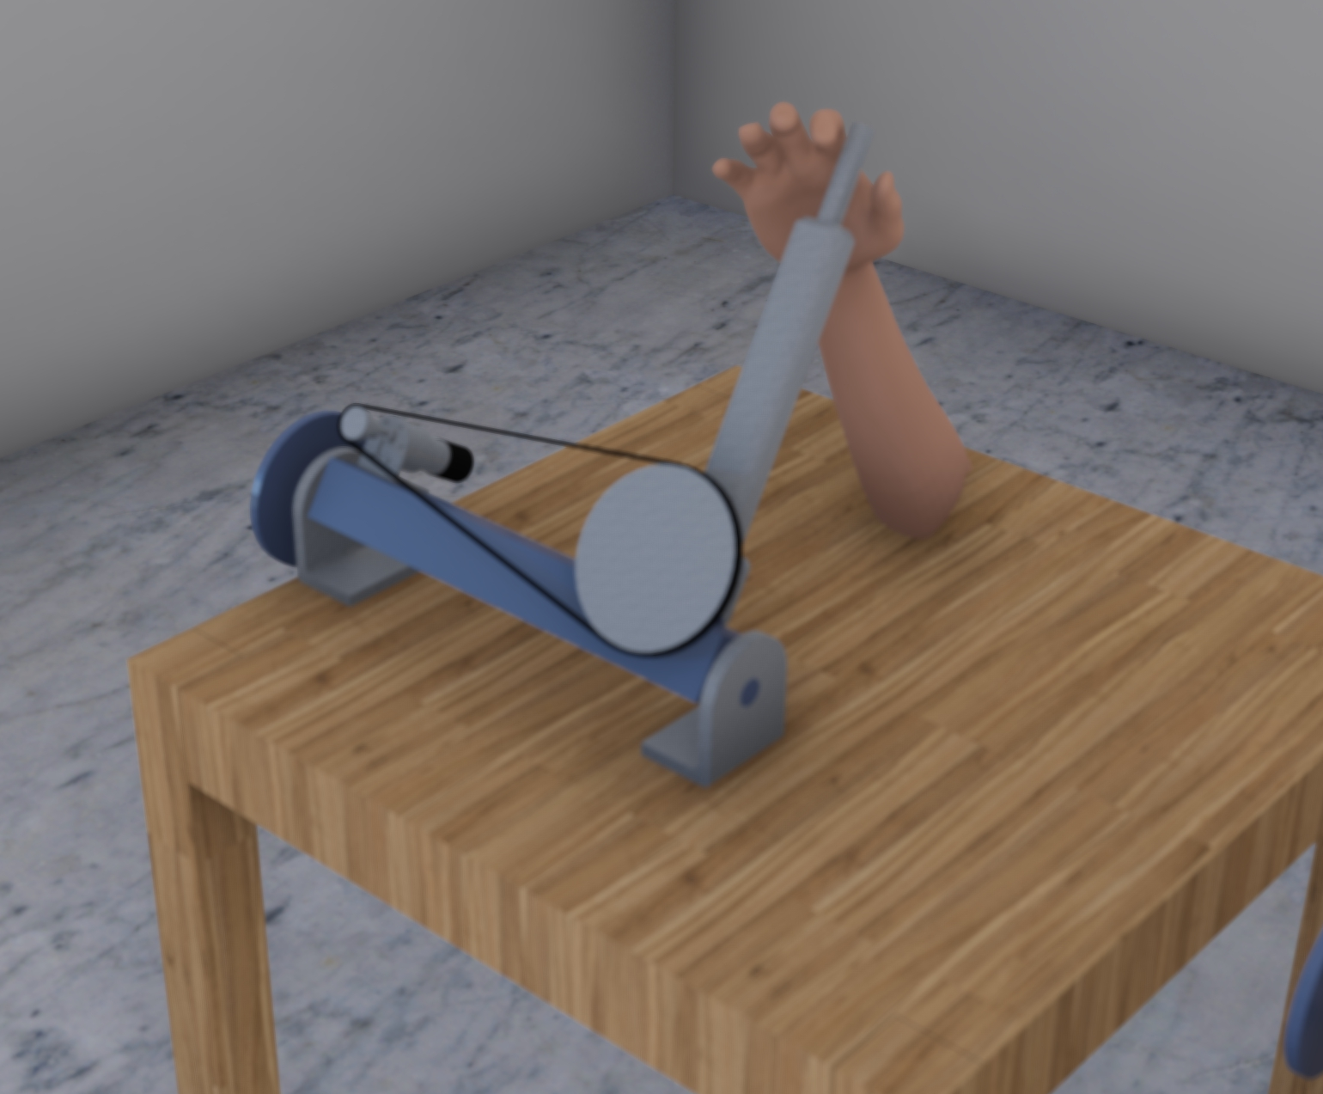
Proposed Solution
[*]
2 DOF
Max torque: 72 Nm
DC servo motor actuators
Torque multiplication with gearbox and a chain/sprocket system
A fair-game algorithm
2 independent torque sensors
Position control with encoder output and PID controller
Me429 - ARM WRESTLING TRAINING ROBOT // Proposed Solution

Slide 6
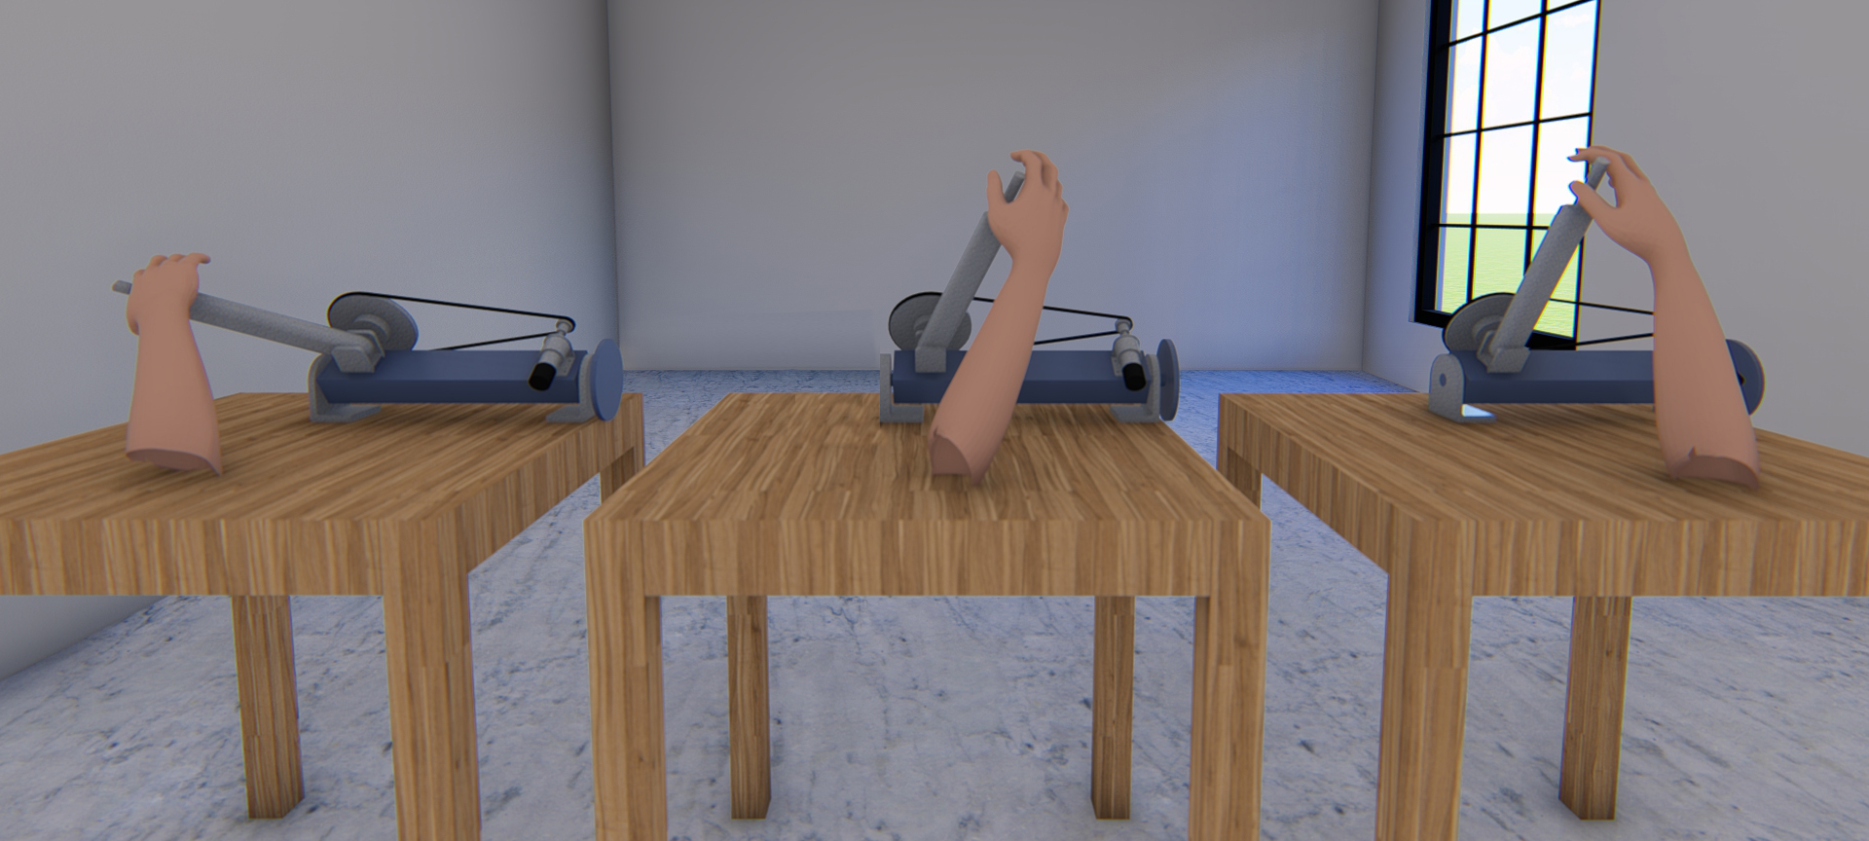
Proposed Solution
[*]
Me429 - ARM WRESTLING TRAINING ROBOT // Proposed Solution

Slide 7
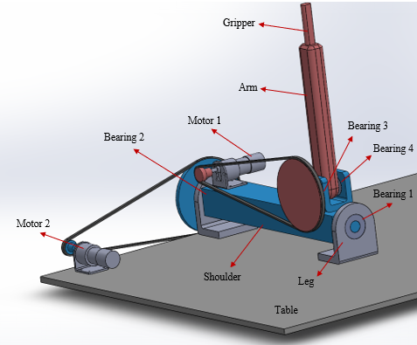
Detailed Design & Analysis
Me429 - ARM WRESTLING TRAINING ROBOT // Detailed Design & Analysis

Slide 8
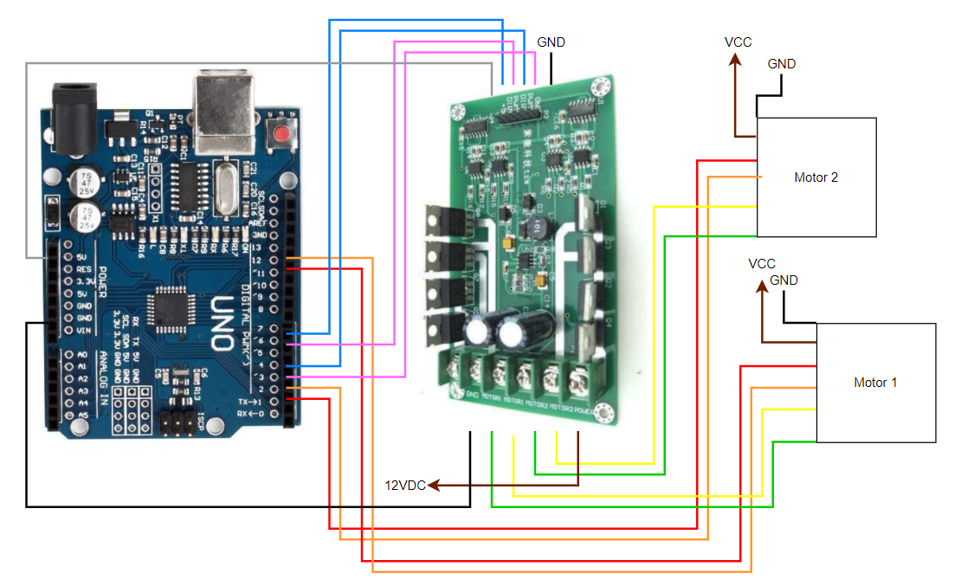
Motor Specifications
Me429 - ARM WRESTLING TRAINING ROBOT // Detailed Design & Analysis

Slide 9
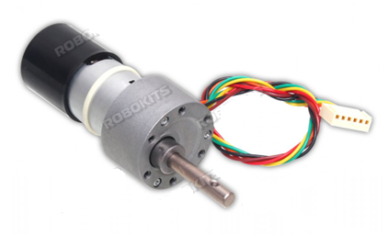
Sensors / Angular Position and Speed
Quadrature Encoder
164 counts per revolution (CPR) on the base motor
265,680 CPR on the output shaft
Resolution: 0.002 degrees
[4]
Me429 - ARM WRESTLING TRAINING ROBOT // Detailed Design & Analysis

Slide 10
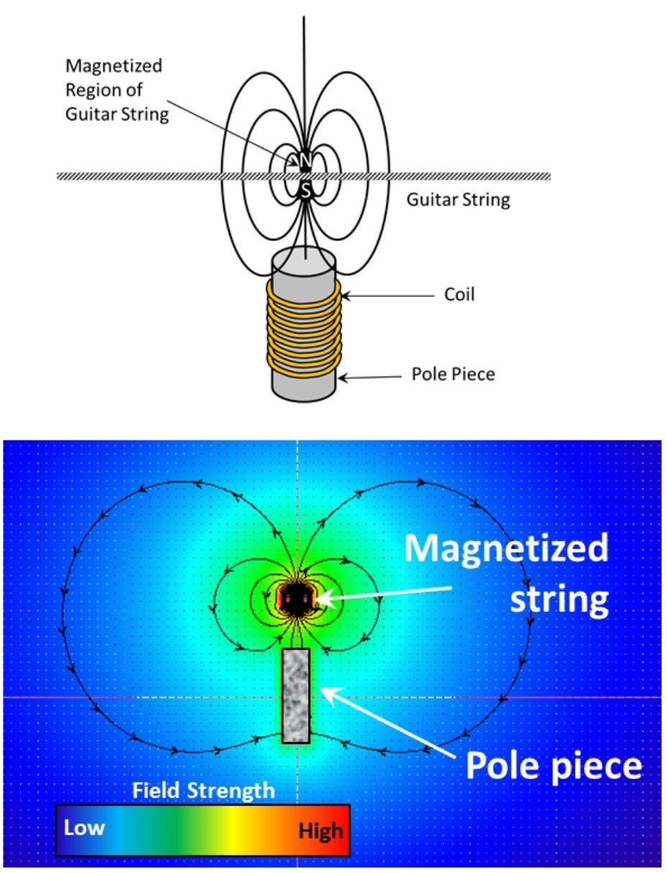
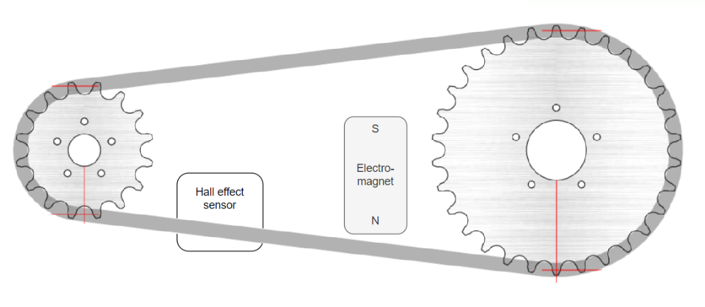
Sensors / Torque
1) Magnetic torque sensor
Consists of a Hall effect sensor and an electromagnet
Works with the same principle as a guitar pick-up.
[5]
Me429 - ARM WRESTLING TRAINING ROBOT // Detailed Design & Analysis

Slide 11
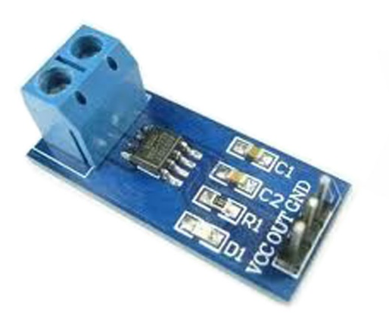
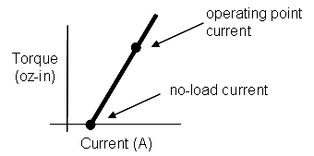
Sensors / Torque
2) ACS712 current sensor:
Hall effect based current sensor
Range: ±20A
Resolution: 100 mV/A
Analog voltage signal proportional to the current
[7]
ACS712 current sensor
[6]
Me429 - ARM WRESTLING TRAINING ROBOT // Detailed Design & Analysis

Slide 12
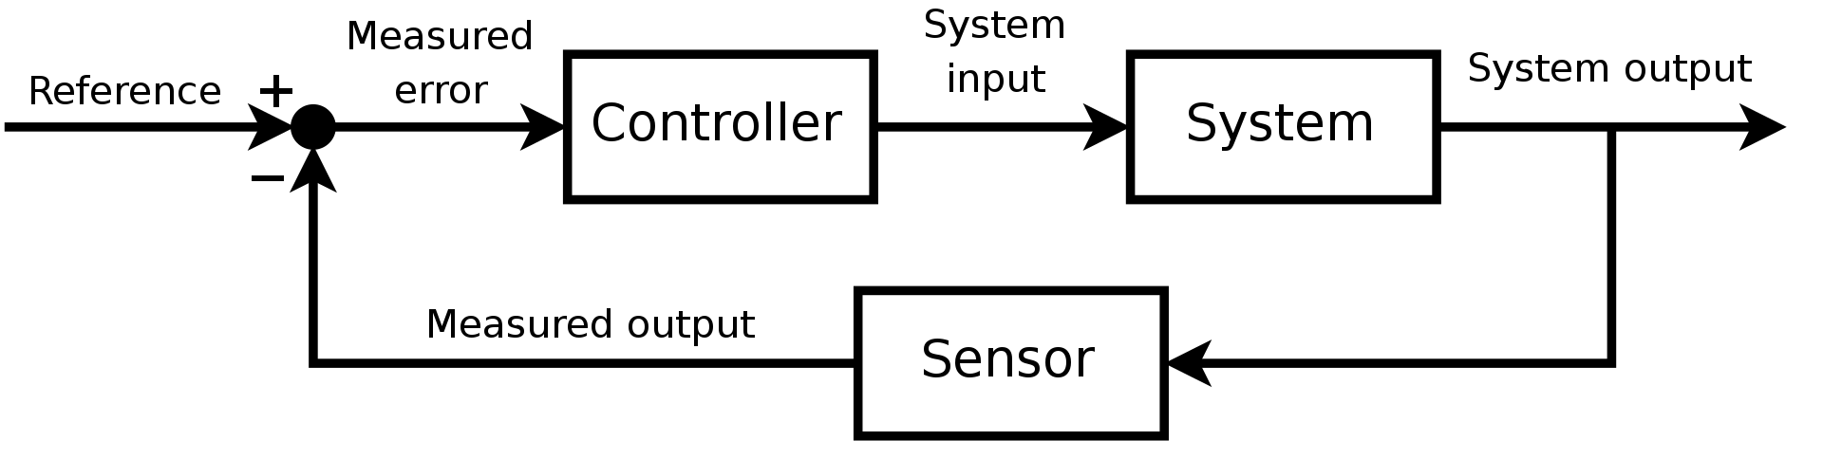
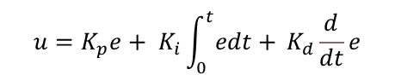
Control Mechanism
The output of a PID controller
in time domain :
$$u=K_{p}e+ K_{i}\int_{0}^{t}{edt+ }K_{d}\frac{d}{dt}e$$
[8]
Me429 - ARM WRESTLING TRAINING ROBOT // Detailed Design & Analysis

Slide 13
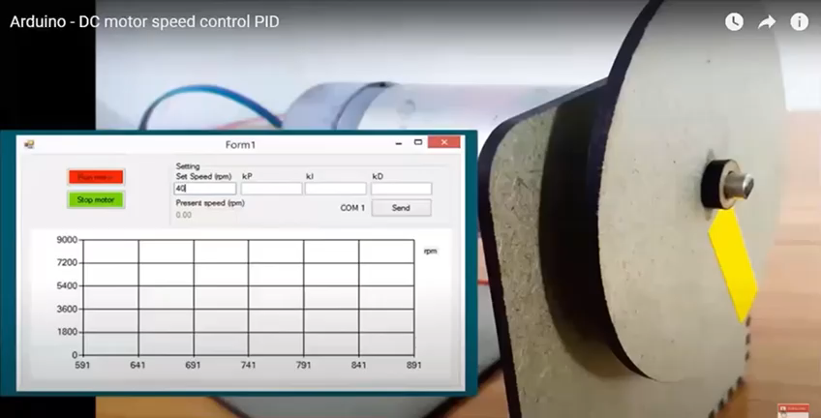
Control Mechanism
[9]
Me429 - ARM WRESTLING TRAINING ROBOT // Detailed Design & Analysis

Slide 14
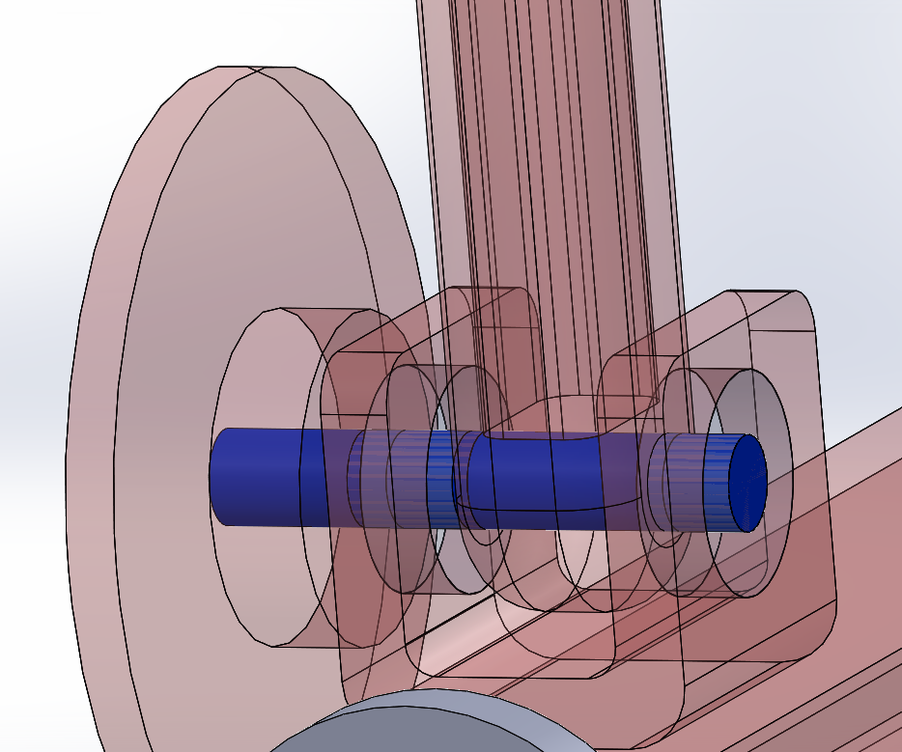
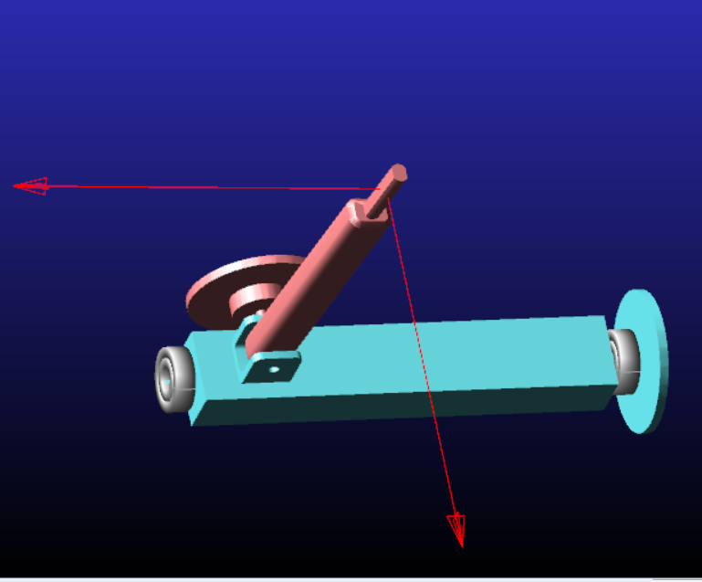

Stress Analysis of the Joint
Joint
Me429 - ARM WRESTLING TRAINING ROBOT // Detailed Design & Analysis

Slide 15
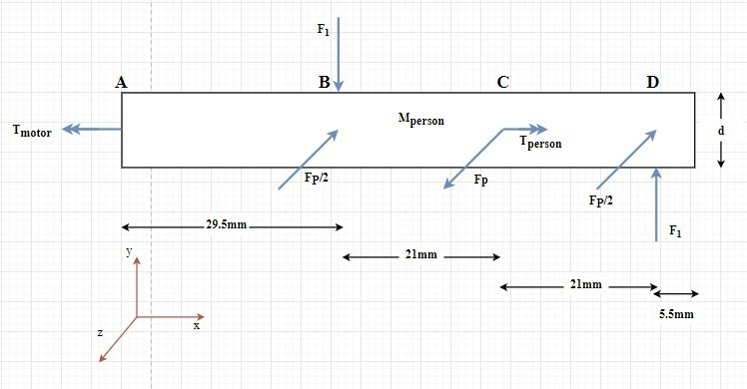
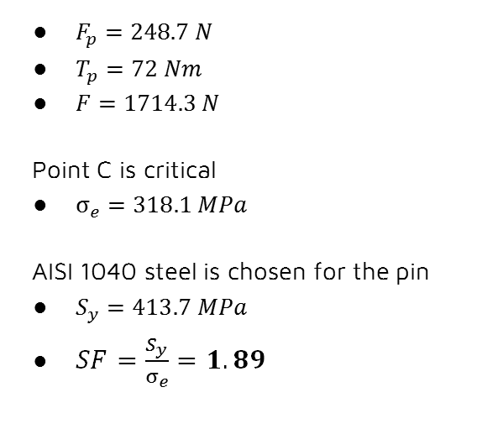
Stress Analysis of the Joint
$F_{p}=248.7 N$
$T_{p}=72 Nm$
$F=1714.3 N$
Point C is critical
$σ_{e}=318.1 MPa$
AISI 1040 steel is chosen for the pin
$S_{y}=413.7 MPa$
$SF=\frac{S_{y}}{σ_{e}}=1.89$
Me429 - ARM WRESTLING TRAINING ROBOT // Detailed Design & Analysis

Slide 16
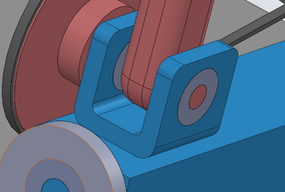
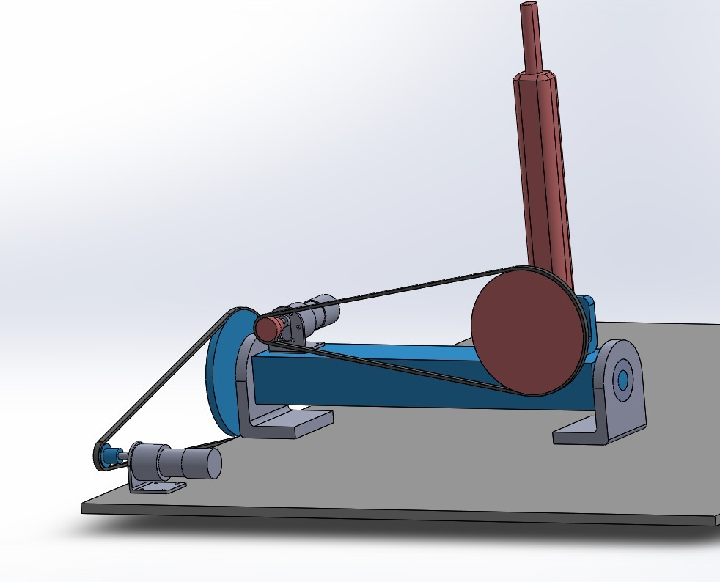





Bearing Selection
Me429 - ARM WRESTLING TRAINING ROBOT // Detailed Design & Analysis

Slide 17
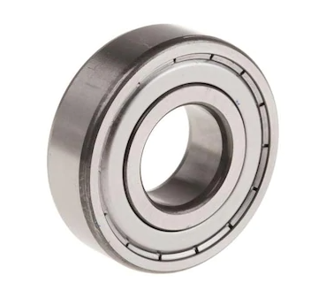
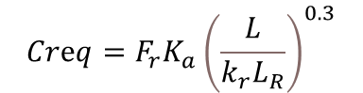
Bearing Selection
$$Crⅇq=F_{r}K_{a}{\left(\frac{L}{k_{r}L_{R}}\right)}^{0.3}$$
Creq = The required value of C for the application
LR = Life corresponding to rated capacity
Fr= Radial load involved in the application
L = Life required by the application
Ka = Application factor
Kr =Reliabilty factor
[10]
Creq_12 = 165. 83 N
Creq_34 = 633.39 N
Bearing 1 & 2 : 6202 Radial Ball Bearing
Bearing 3 & 4 : 6204 Radial Ball Bearing
Me429 - ARM WRESTLING TRAINING ROBOT // Detailed Design & Analysis

Slide 18


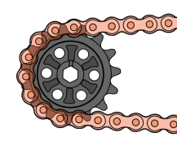
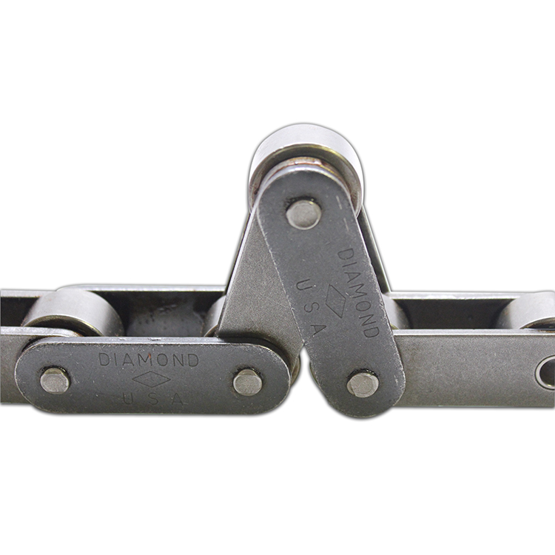
Chain Selection
[12]
[12]
10 rpm working speed
Low horsepower
Low required lifetime
[11]
Me429 - ARM WRESTLING TRAINING ROBOT // Detailed Design & Analysis

Slide 19
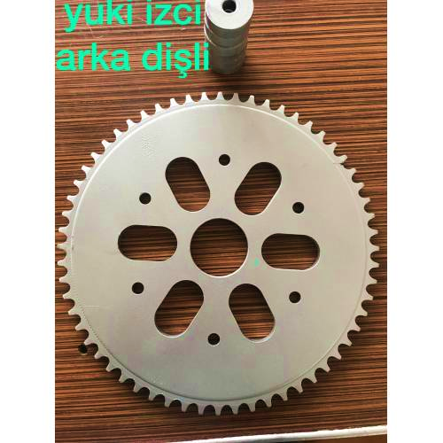
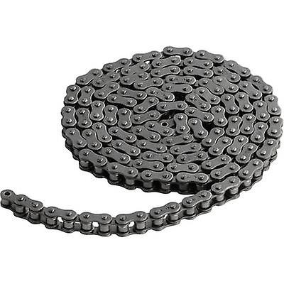
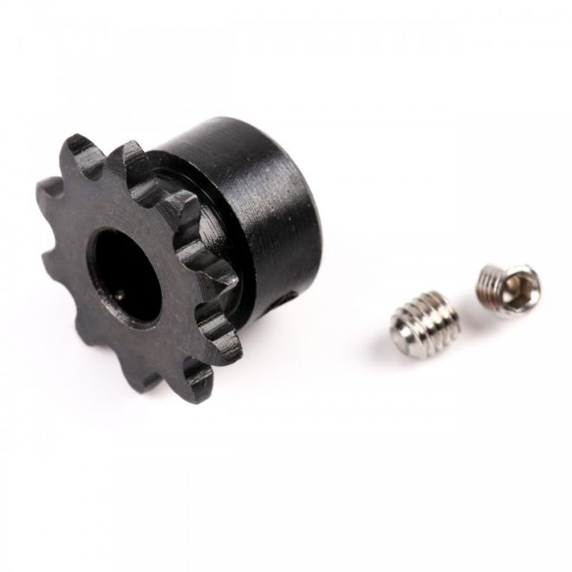
Chain Selection
[15]
[14]
[13]
10 tooth sprocket for #25 ANSI roller chain
820 mm Chain
#25 ANSI roller chain
60 tooth sprocket for #25 ANSI roller chain
Me429 - ARM WRESTLING TRAINING ROBOT // Chain Selection

Slide 20

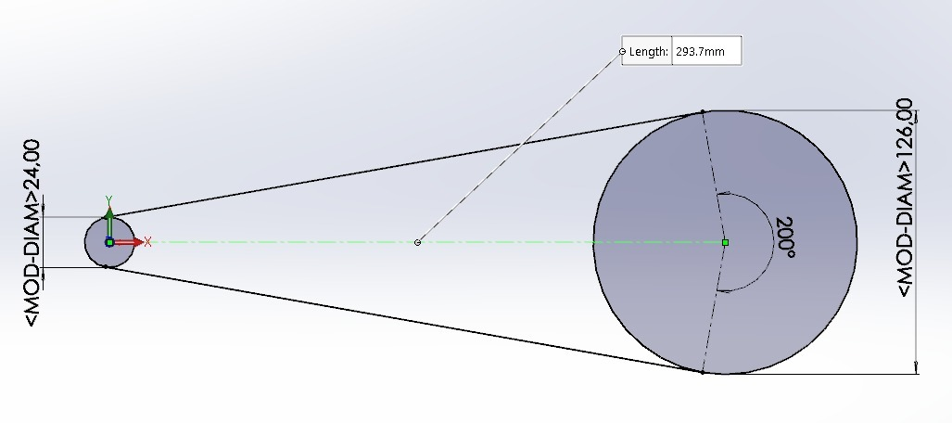
Chain Selection
120° <= Wrap angle <= 200°
Center to center distance
Me429 - ARM WRESTLING TRAINING ROBOT // Detailed Design & Analysis

Slide 21
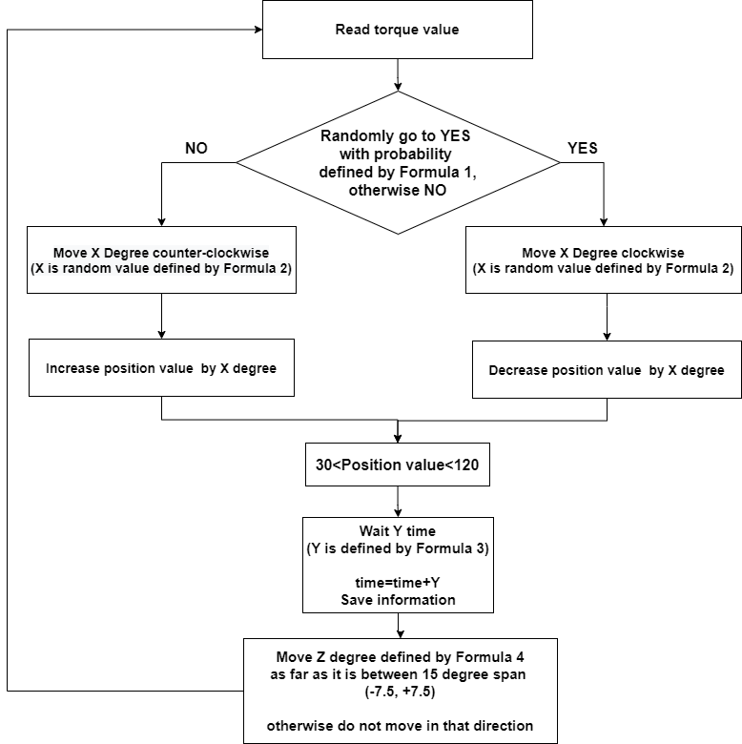
Algorithm
Recursive Algorithm
30 < Position Value < 120
Formula 1:
Improvement Consideration
Strenth
Fatigue
Formula 2-3-4:
Generate uniform random numbers
Me429 - ARM WRESTLING TRAINING ROBOT // Detailed Design & Analysis

Slide 22
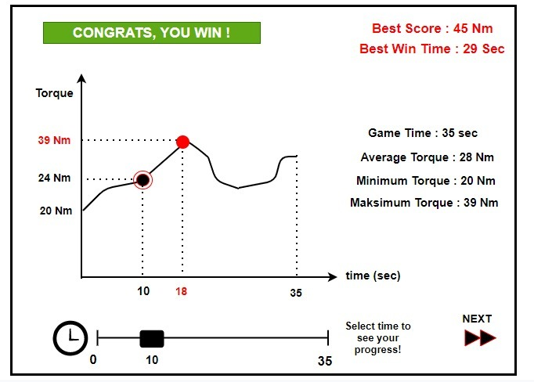
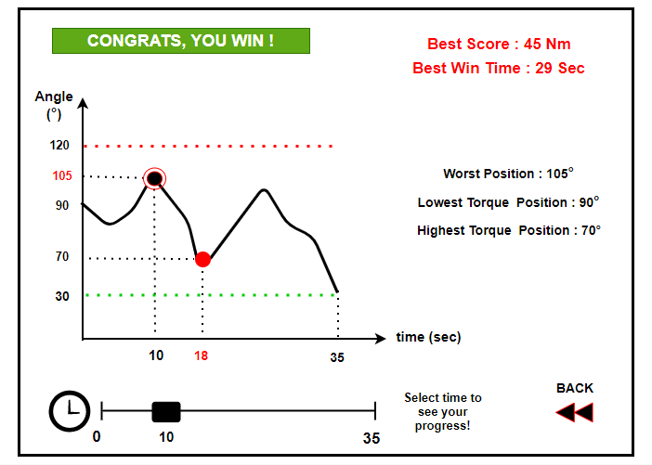
Feedback Screen
Home Page
Next Page
*The angle convention is CCW from robot perspective. Below 30 degrees the robot loses and human wins.
Me429 - ARM WRESTLING TRAINING ROBOT // Detailed Design & Analysis
Notes:
Bu mtootr gerekli hareketleri sagliyor

Slide 23

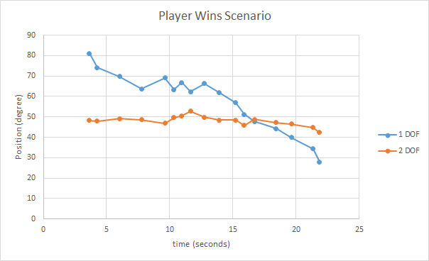
Conclusion - Human Wins Scenario
Me429 - ARM WRESTLING TRAINING ROBOT // Conclusion

Slide 24

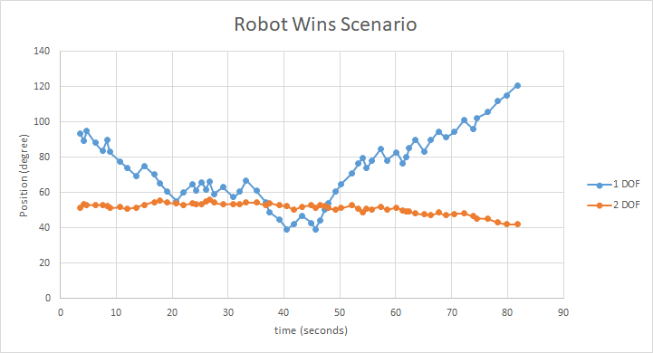
Conclusion - Robot Wins Scenario
Me429 - ARM WRESTLING TRAINING ROBOT // Conclusion

Slide 25
Cost Analysis
Product Name | Quantity | Unit Cost(TL) | Price
Motor Drive | 1 | 216 | 216
60T sprocket (#25) | 2 | 199 | 398
Chain (#25) | 2 | 179 | 358
Motor | 2 | 175 | 350
10T sprocket (#25) | 2 | 33 | 66
Current sensor | 2 | 16 | 32
Hall effect sensor | 2 | 13 | 26
Bracket | 2 | 12 | 24
Bearing 15x35x11 | 2 | 5 | 10
Bearing 20x42x12 | 2 | 5 | 10
M5 screw-nut | 8 | 0,25 | 2
M5 screw | 8 | 0,25 | 2
M3 screw | 2 | 1 | 2
Arduino Uno | 1 | 22,89 | 22,89
TOTAL COST |  |  | 1533,2 TL
Total Cost= 1533,2 TL
Me429 - ARM WRESTLING TRAINING ROBOT // Cost Analysis

Slide 26
REFERENCES
[1] [Online]. Available: https://fitnessvolt.com/larry-wheels-arm-wrestling-schoolboy/.
[2] «Workouty Arm Wrestling Training Equipment,» Amazon, [Online]. Available: https://www.amazon.com/Workouty-Wrestling-Equipment-Developer-Exerciser/dp/B07VS3DLPK.
[3] "Arm wrestling. Man vs robot. 3D animation.," [Online]. Available: https://www.shutterstock.com/tr/video/clip-5129345-arm-wrestling-man-vs-robot-wins-3d.
[4] https://robokits.co.in/motors/encoder-dc-servo/high-torque-quad-encoder-geared-dc-motor-12v-10rpm.
[5] https://en.wikipedia.org/wiki/Hall_effect
[6] D. Collins, "What’s the relationship between current and dc motor output torque?," [Online]. Available: https://www.motioncontroltips.com/faq-whats-the-relationship-between-current-and-dc-motor-output-torque/.
[7] https://www.direnc.net/acs712-akim-sensoru-20a-20a-modul
[8] https://www.javatpoint.com/control-system-tutorial
[9] https://www.youtube.com/watch?v=Oai8qMH2yTU
[10] https://urun.n11.com/oem-yedek-parca/6204-zz-rulman-20x47x14-P464439335?gclsrc=aw.ds&&gclid=CjwKCAiAjp6BBhAIEiwAkO9WupWxBusONvg475-DbCFy6qMzEQcsA0ynbYaCGWcwq3ccS71oVcu2NRoCHv0QAvD_BwE
[11] https://www.peerchain.com/product/ansi-double-pitch-roller-conveyor-chains-c-type-standard-rollers/
Me429 - ARM WRESTLING TRAINING ROBOT // References

Slide 27
[12] https://fgcteamgreece.weebly.com/uploads/4/4/1/1/44111347/20180507_sprocket_guide.pdf
[13] https://www.robotistan.com/04c-10t-zincir-dislisi
[14] https://www.fruugo.com.tr/modelcraft-celik-makaral-zincir-1000-mm/p-5633437-12662764?language=tr&ac=google
[15] https://www.gittigidiyor.com/otomobil-motor-aksesuar/yuki-izci-arka-disli-60-dis_pdp_562715785?utm_source=google-pla&utm_medium=paid-search&utm_content=402981508442&utm_term=88775784907&ga_prodid=562715785&ga_merchantid=238753684&sc_gcsp=gg&gclid=CjwKCAiAjp6BBhAIEiwAkO9WuqKqicYtwhCLQyjyxwcXaGAt3fr71A-Z0C8Et2tzOxzE34TDjOErGBoCEI8QAvD_BwE
*Special thanks to Ahmet Bayer for his help about rendering.
https://3dwarehouse.sketchup.com/model/02453090-9765-4dbd-a08a-e2acaa83ab54/hand
Me429 - ARM WRESTLING TRAINING ROBOT // References

Slide 28

THANK YOU FOR
LISTENING
Me429 - ARM WRESTLING TRAINING ROBOT

Slide 29
BACK UP SLIDES
Me429 - ARM WRESTLING TRAINING ROBOT // Back Up Slides

Slide 30
Working Algorithm
MODE 3:
ENTERTAINMENT
03
MODE 1:
TRAINING
01
02
MODE 2:
COMPETITION
Me429 - ARM WRESTLING TRAINING ROBOT // Working Algorithm

